Slide 1

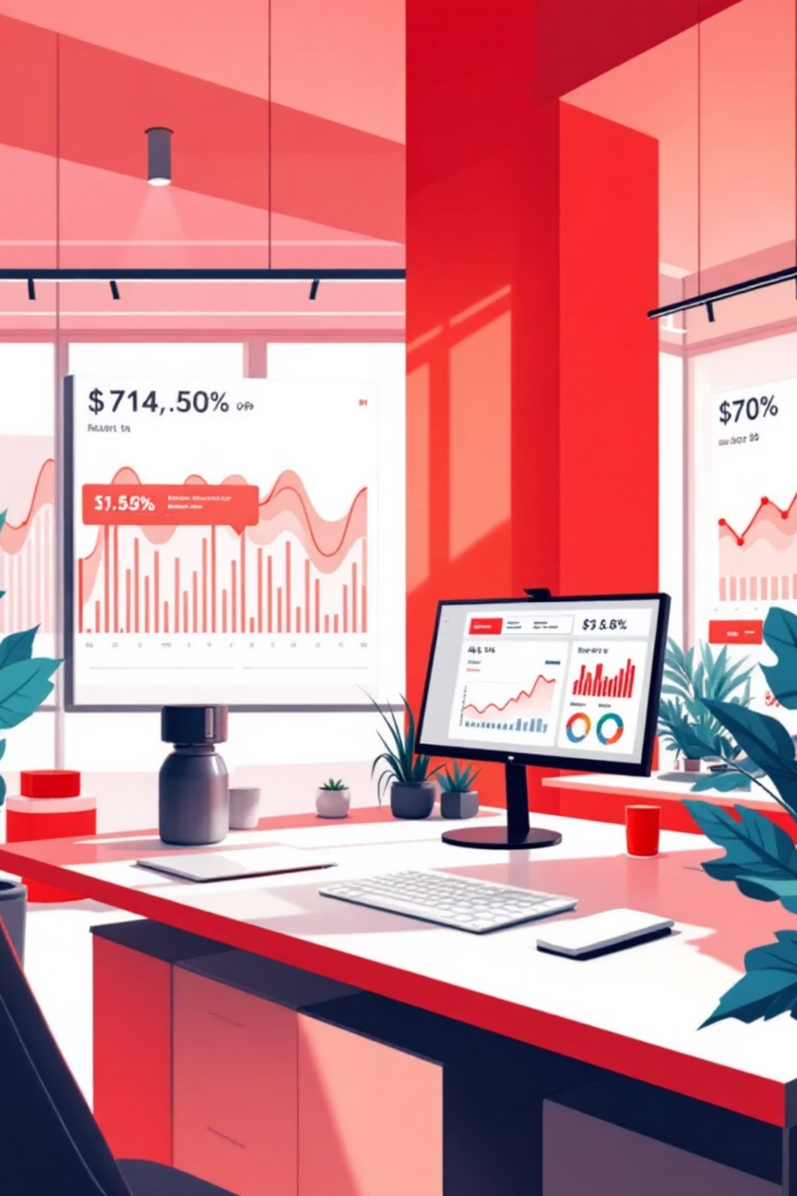
Customer Segmentation & Shopping Behavior Analysis
A comprehensive data-driven study exploring retail purchase patterns across the U.S. market to unlock targeted marketing opportunities and optimize discount strategies
Notes:
1

Slide 2

PROJECT GOALS
Objective of the Project
Purchasing Pattern Analysis
Strategic Discount Optimization
Identify and analyze customer purchasing behaviors across product categories and demographics
Determine which product categories benefit most from promotional pricing strategies
Behavioral Segmentation
Marketing Strategy Development
Study spending patterns based on age, season, and location to create meaningful customer segments
Propose targeted marketing approaches tailored to distinct customer groups
Notes:
2

Slide 3

Dataset Overview
Data Source & Scale
The analysis utilized approximately 3,900 customer records extracted from a client-hosted MySQL database, providing a robust sample of U.S. retail purchase behavior.
Key Data Attributes
Customer demographics (age, gender, location)
Purchase details (category, amount, payment method)
Behavioral indicators (discount usage, purchase history)
Temporal factors (season, transaction timing)
Notes:
3

Slide 4




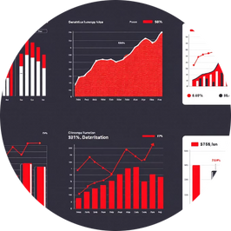

TECHNOLOGY STACK
Tools & Technologies Used
MySQL
Python
Pandas & NumPy
Matplotlib & Seaborn
Data storage and extraction through optimized SQL queries
Core analysis environment for data processing and modeling
Data manipulation and numerical computation framework
Advanced visualization libraries for insight generation
Scikit-learn
Machine learning toolkit for clustering and segmentation analysis
Notes:
4

Slide 5
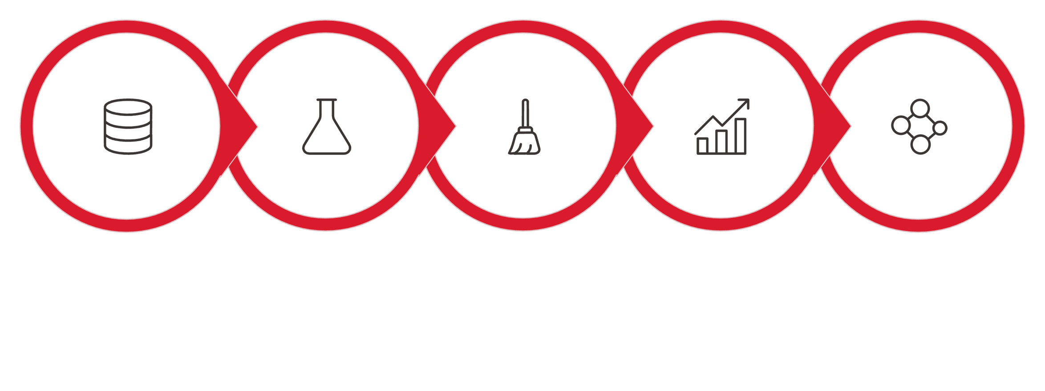





Data Extraction & Preparation Workflow
Extract
Load
Clean
Encode
Ready
Our comprehensive data preparation workflow ensured data quality and readiness for advanced analytics. The process included extracting records via SQL queries, cleaning and preprocessing to handle missing values and duplicates, encoding categorical variables for machine learning compatibility, and scaling numerical features to optimize clustering performance.
Notes:
5

Slide 6

Exploratory Data Analysis
Deep dive into customer spending patterns revealed critical insights across multiple dimensions of retail behavior.
Spending Pattern Analysis
Discount Response Study
Multi-Factor Behavior
Determined which categories showed strongest positive response to promotional offers
Analyzed spending variations by age groups, seasonal trends, and geographic location
Identified purchase behaviors across customer demographics and product categories
Notes:
6

Slide 7
Customer Segmentation Results
Methodology
3 Distinct Customer Clusters Identified
K-Means clustering algorithm was applied to segment customers based on three key dimensions: age, purchase amount, and previous purchase history. This unsupervised learning approach revealed natural groupings within the customer base.
1
High-Value Customers
Segmentation Factors
Premium spenders with large transaction sizes
Customer age demographics
Average purchase amount
Historical purchase frequency
2
Discount-Sensitive Customers
Price-conscious shoppers responding to promotions
3
Loyal Customers
Frequent purchasers with consistent engagement
Notes:
7

Slide 8




STRATEGIC RECOMMENDATIONS
Business Insights & Marketing Strategy
Tailored marketing approaches designed to maximize engagement and revenue for each customer segment.
High-Value Customers
Discount-Sensitive
Loyal Customers
Exclusive premium offers, early access to new products, and VIP experiences
Strategic promotional deals, limited-time offers, and bundle discounts
Loyalty rewards programs, subscription benefits, and personalized recommendations
Notes:
8

Slide 9

Key Performance Metrics
3.9K
3
5
Customer Records
Customer Segments
Technologies
Analyzed for comprehensive insights
Distinct clusters identified
Integrated for analysis workflow
Notes:
9

Slide 10



Conclusion & Impact
End-to-End Analytics Workflow
This project demonstrates a complete data analytics lifecycle, from initial data extraction through MySQL to actionable business insight generation using advanced machine learning techniques.
Revenue Growth
Enhanced Engagement
Optimized strategies for each segment
Measurable Business Value
Personalized customer experiences
The findings provide concrete, actionable recommendations that retail companies can implement to improve customer engagement, optimize discount allocation, and increase overall revenue through targeted marketing strategies.
Targeted Marketing
Data-driven campaign precision
Notes:
10

